Slide 1
DL CAPSTON PROJECT
‘BRAIN TUMOR IMAGE CLASSIFICATION’
BY
SWAPNIL POWAR

Slide 2
PROBLEM STATEMENT:
THE DATASET CONTAINS THE FOUR TYPES OF IMAGES OF BRAIN TUMOR i.e. GLIOMA TUMOR, MENINGIOMA TUMOR, PITUITARY TUMOR, NO TUMOR. ONE NEED TO CLASSIFY THESE IMAGES BASED ON CNN ARCHITECTURE.

Slide 3
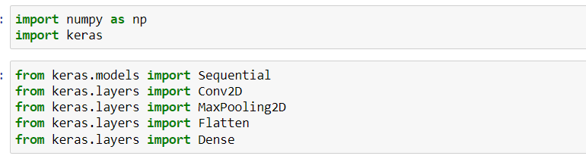
METHODOLOGY:
1. IMPORTING VARIOUS LIBRARIES

Slide 4
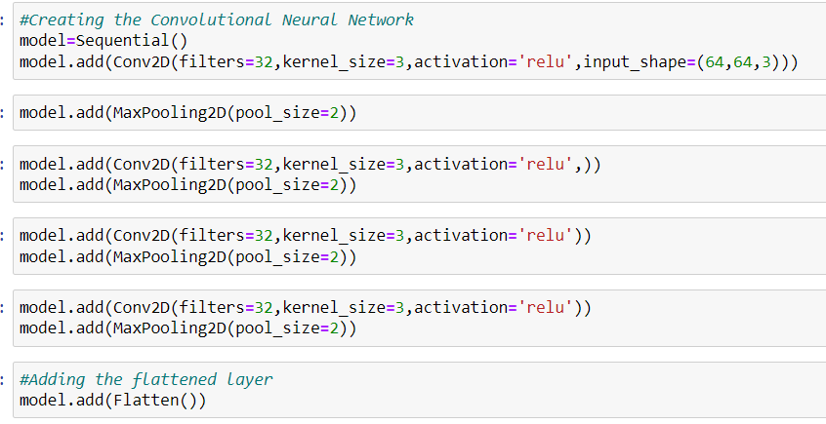
2. CREATING THE CNN ARCHITECTURE.

Slide 5
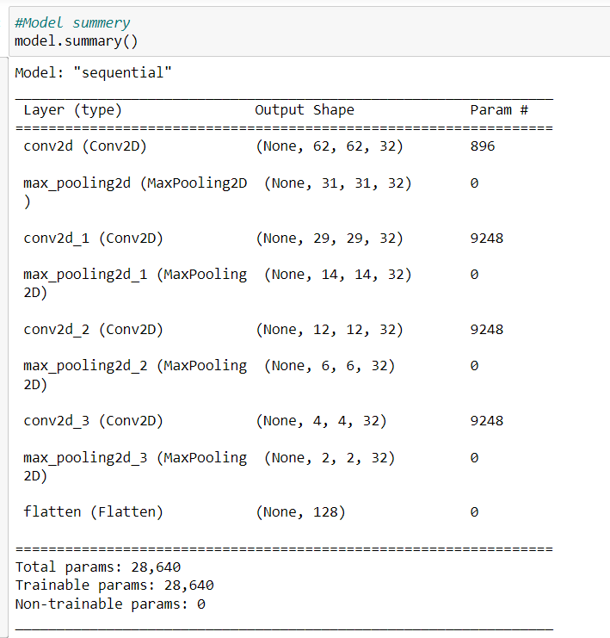
3. ANALYSING SUMMARY OF THE MODEL.

Slide 6
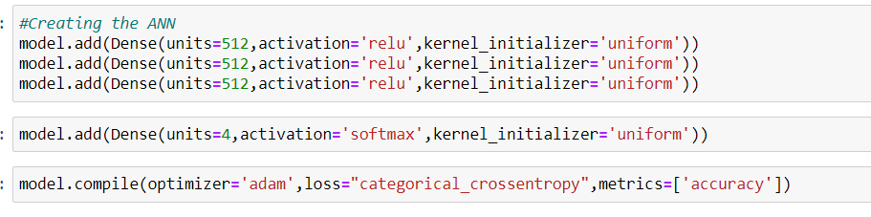
4. CREATING THE ANN ARCHITECTURE WITH UNIFORM WEIGHT INITIALISATION.
AT THE END LAYER SOFTMAX FUNCTION IS USED IN ORDER TO SELECT 1 OUT OF 4.

Slide 7
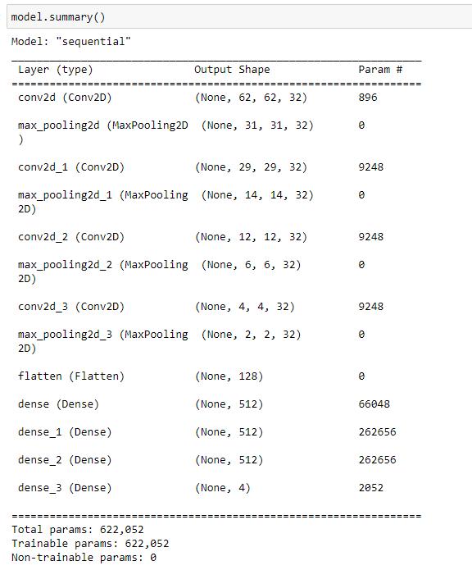
5. ANALYSING FULL NETWORK SUMMARY.

Slide 8
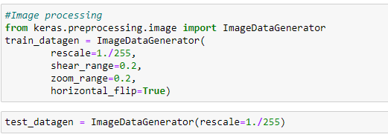
5.IMAGE AUGUMENTATION.

Slide 9
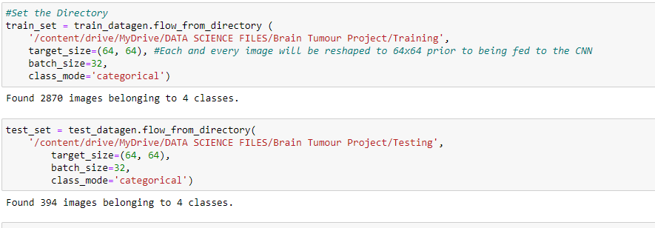
6. SETTING THE DIRECTORY.

Slide 10
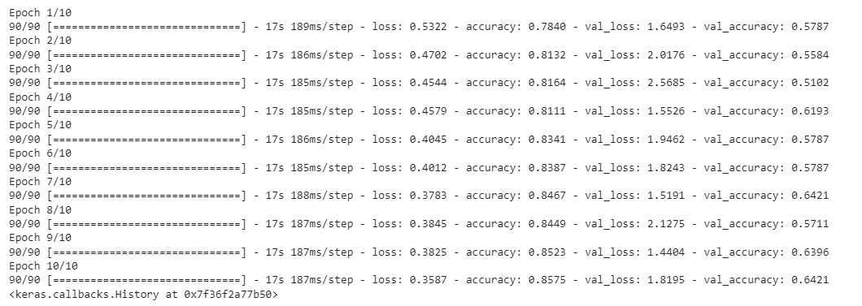
7. MODEL FITTING AND NETWORK GOES UNDERTHROUGH THE EPOCHS.

Slide 11
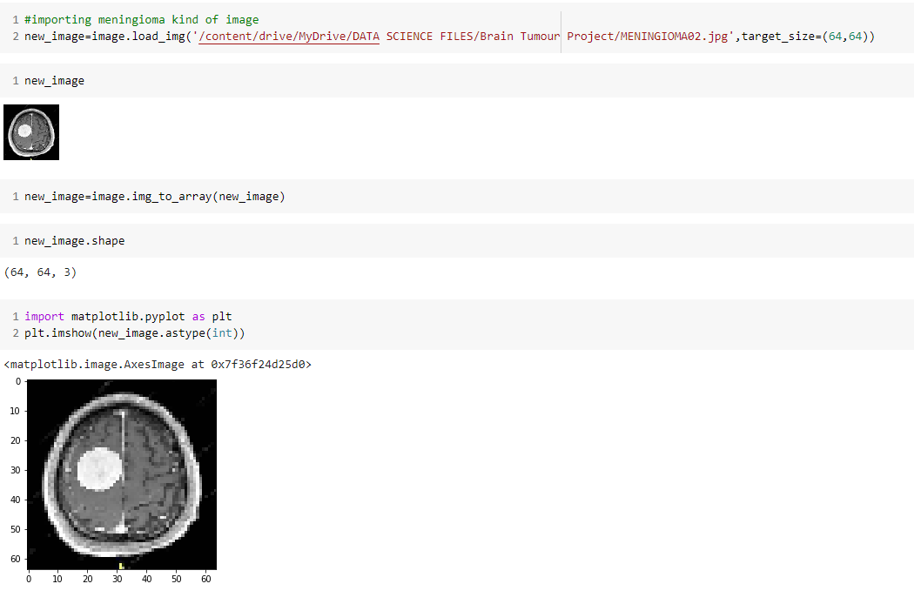
8. TESTING A MENINGIOMA KIND OF IMAGE IMPORTED FROM OUTSOURCE.

Slide 12
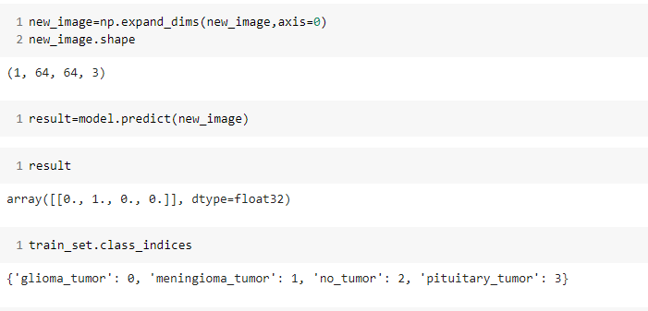
9. PREDICTING THE IMAGE CLASSIFICATION.
PREDICTED CORRECTLY THE MENINGIOMA KIND OF TUMOR.

Slide 13
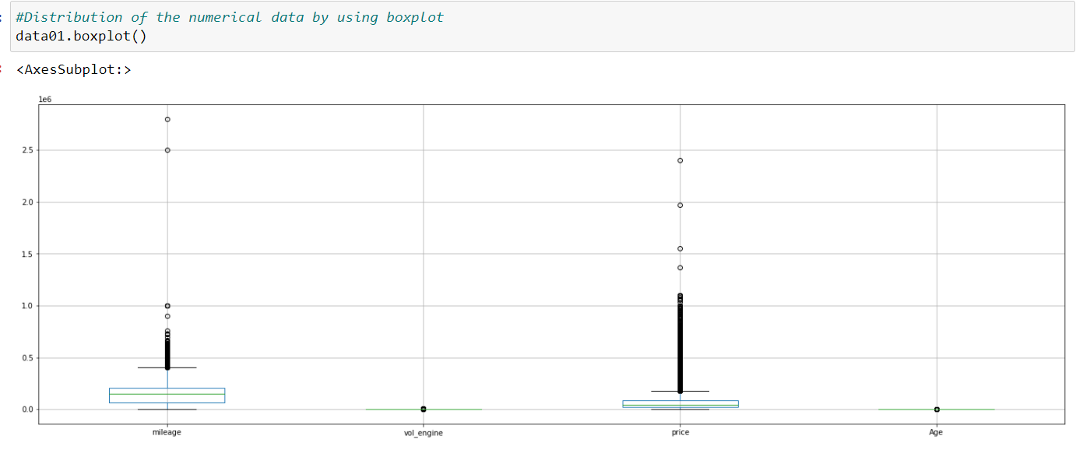
KEY FINDING STEP FOR REMOVING OUTLIERS:
10. CHECKING OF THE OUTLIERS IN THE DATA IF ANY.

Slide 14
HELP FOR BUSSINESS:
MEDICAL SCIENCE PROFESSIONALS NEED NOT TO BE SPENT THE TIME ON ANALYSING THE TUMOR IMAGES. DIRECTLY THIS NETWORK WILL HELP IN CLASSIFICATION OF TUMOR IF PETIENT HAVE ANY.

